Slide 1
Java Database Connectivity (JDBC)

Slide 2
Java DataBase Connectivity
• JDBC (Java DataBase Connectivity) - provides access to relational database systems
• JDBC is a vendor independent API for accessing relational data from different vendors (Microsoft Access, Oracle) in a consistent way
• The language SQL (Structured Query Language) is normally used to make queries on relational data
• JDBC API provides methods for executing SQL statements and obtaining results: SELECT, UPDATE, INSERT, DELETE etc.
• Provides portability (eliminates rewriting code for different databases and recompiling for different platforms) and faster, reusable object developing environment
• JDBC API is part of core Java

Slide 3
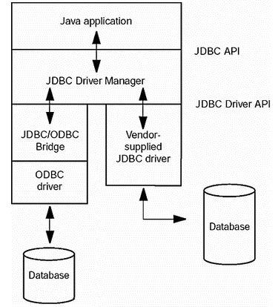
JDBC-to-database communication

Slide 4
JDBC Architecture
Application
JDBC
Driver
Java code calls JDBC library
JDBC loads a driver
Driver talks to a particular database
Can have more than one driver -> more than one database
Advantage: can change database engines without changing any application code

Slide 5
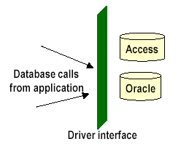
Vendor specific APIs - JDBC Drivers
Database vendors provide proprietary APIs for accessing data managed by the server.
JDBC aims at providing an API that eliminates vendor specific nature in accessing a database
However, JDBC still requires a vendor-specific driver for accessing database from a particular vendor
The driver provides interface between JDBC API and vendor database by converting calls from JDBC API to vendor’s database calls
Example drivers:
- JDBC/ODBC driver: sun.jdbc.odbc.JdbcOdbcDriver
- Oracle driver: oracle.jdbc.driver.OracleDriver

Slide 6
JDBC Drivers
Type I: “Bridge”
Type II: “Native”
Type III: “Middleware”
Type IV: “Pure”

Slide 7
JDBC Drivers
JDBC
Type I
“Bridge”
ODBC
ODBC
Driver
Type II
“Native”
CLI (.lib)
Type III
“Middleware”
Middleware
Server
Type IV
“Pure”

Slide 8
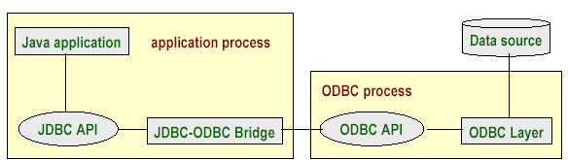

JDBC Driver Types
Type 1: JDBC-ODBC Bridge
• ODBC (Open Database Connectivity) is Microsoft’s API for SQL; popular on Windows platform
• ODBC API provides a set of functions for accessing a database
• JDBC drivers of this type translate calls from JDBC into corresponding ODBC calls

Slide 9
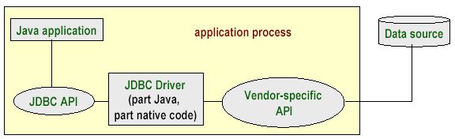
Type 2 - Part Java, Part Native Driver
JDBC driver consists of java code and native code which uses vendor-specific API for accessing databases
More efficient than JDBC-ODBC bridge due to fewer layers of communication
Typical of this type of driver is the driver provided by IBM for its DB2 Universal Database (UDB).

Slide 10
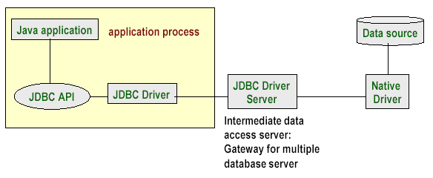
Type 3 - Intermediate Database Access Server
Calls middleware server, usually on database host
Very flexible -- allows access to multiple databases using one driver
Only need to download one driver
But it’s another server application to install and maintain

Slide 11
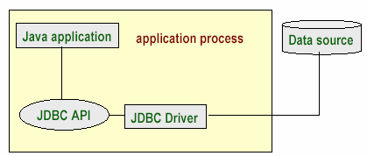
Type 4 - Pure Java Driver
100% Pure Java
Use Java networking libraries to talk directly to database engines
Only disadvantage: need to download a new driver for each database engine
JDBC calls are directly translated to database calls specific to vendor
Very efficient in terms of performance and development time

Slide 12
JDBC Overview
Core JDBC Components
JDBC Drivers
Connections
Statements
Result Sets
Common JDBC Use Cases
Query the database (read data from it).
Query the database meta data.
Update the database.
Perform transactions.

Slide 13
JDBC Object Classes
Driver
A JDBC driver is a collection of Java classes that enables you to connect to a certain databaseto actual database
Connection
Once a JDBC driver is loaded and initialized, you need to connect to the database. You do so by obtaining a Connection to the database via the JDBC API and the loaded driver. All communication with the database happens via a connection. An application can have more than one connection open to a database at a time.

Slide 14
JDBC Object Classes
Statement
A Statement is what you use to execute queries and updates against the database. There are a few different types of statements you can use
ResultSet
When you perform a query against the database you get back a ResultSet. You can then traverse this ResultSet to read the result of the query

Slide 15
JDBC Operation
Query the database
One of the most common use cases is to read data from a database. Reading data from a database is called querying the database.
Query the database meta data
Another common use case is to query the database meta data. The database meta data contains information about the database itself. For instance, information about the tables defined, the columns in each table, the data types etc.

Slide 16
JDBC Operation
Update the database
Another very common JDBC use case is to update the database. Updating the database means writing data to it. In other words, adding new records or modifying (updating) existing records.
Perform transactions
Transactions is anoter common use case. A transaction groups multiple updates and possibly queries into a single action. Either all of the actions are executed, or none of them are.

Slide 17
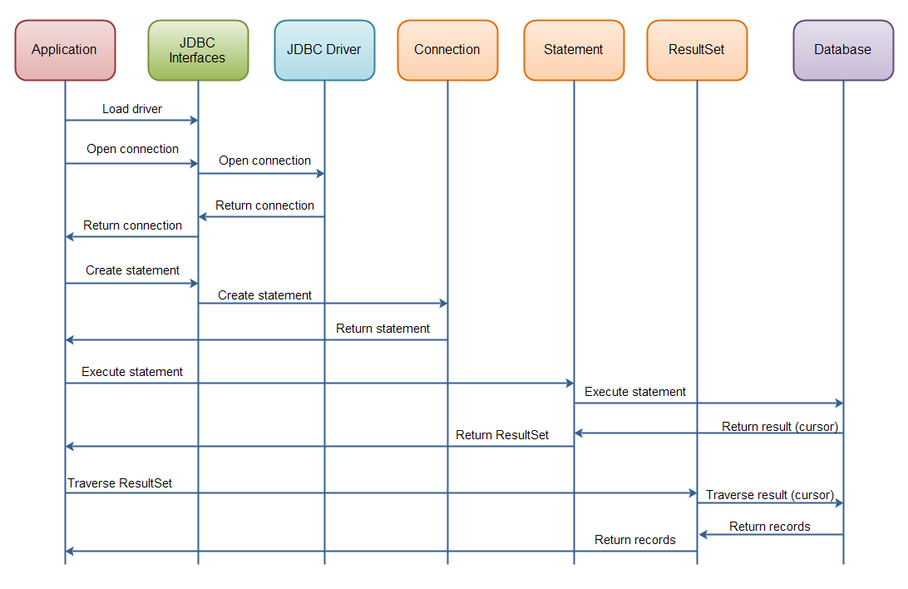
JDBC Interaction Diagram

Slide 18
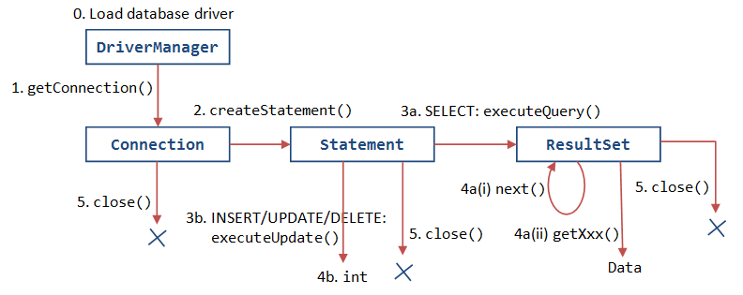
JDBC Cycle

Slide 19
JDBC URLs
jdbc:subprotocol:source
each driver has its own subprotocol
each subprotocol has its own syntax for the source
jdbc:odbc:DataSource
e.g. jdbc:odbc:Northwind
jdbc:msql://host[:port]/database
e.g. jdbc:msql://example.com:4333/empl

Slide 20
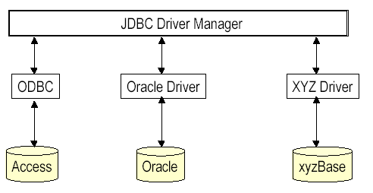
JDBC Driver Manager
JDBC key components: DriverManager, Connection, Statement, ResultSet
DriverManager handles communication with different drivers that conform to JDBC Driver API.
- The static class DriverManager manages the loaded drivers and contains methods for accessing connections to the databases

Slide 21
Four steps in creating a database application
Step 1: load a database driver
Step 2: make a database connection
Step 3: create and execute SQL statement
Step 4: process the result set, if necessary

Slide 22
Step 1: Loading a Driver
A driver is always needed to obtain a connection
Loading a driver requires class name of the driver.
For JDBC-ODBC driver the class name is: sun.jdbc.odbc.JdbcOdbcDriver
Oracle driver is: oracle.jdbc.driver.OracleDriver
The class definition of the driver is loaded using forName static method of the class Class (in package java.lang)
try {
Class.forName("sun.jdbc.odbc.JdbcOdbcDriver");
} catch (Exception e) {
out.println( e.getMessage() + "\n Class not found Exception.");
}
The class DriverManager manages the loaded drivers

Slide 23
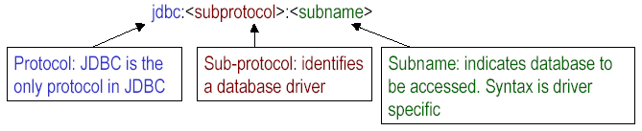
Step 2: Opening a Database Connection
• getConnection method of DriverManager class returns a connection
• When there are several databases used by the same application, the driver required to access the database is uniquely identified using JDBC URLs
JDBC URL: Represents a driver and has following three-part syntax
Examples: "jdbc:odbc:books” : specifies database books as ODBC data source (books is a logical name linked to actual database)

Slide 24
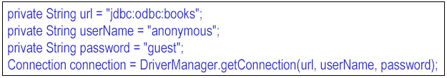
Step 2: Opening a Database Connection(contd.)
• Getting a connection to ODBC data source books (MS Access database)
• DriverManager has other variants of getConnection method that accept different set of parameters
• Connection is an interface defined in java.sql package. A Connection object represents a connection with the database. The interface has methods to create statements which can be used to manipulate the database

Slide 25
Step 3: executing SQL Statements
Connection objects can be used to create statement objects.
statement = connection.createStatement();
Statement is an interface that contains methods for executing SQL queries
sqlStr contains a string which is an SQL statement for inserting a new record in the table Authors in the books database
The SQL statement is executed using executeUpdate method of the statement object
The method is used to execute statements like INSERT, UPDATE, DELETE that do not return any results. It returns number of rows affected

Slide 26
Step 4: Enquiring the Database
The Statement object returns a java.sql.ResultSet object upon executing an SQL statement using executeQuery method
The method returns all rows in Authors table as a ResultSet
The next() method of ResultSet allows to move from one row to the next row
while (rs.next()) {
// rs stands for a row in each iteration; print author details
}
ResultSet contains several methods for extracting various fields in a row. The methods require column name or column index as an argument.
rs.getString( "FirstName" )
FirstName is the colum name. The method returns author’s first name which is a string

Slide 27
Register a database as an ODBC Data Source
• The computer should have Microsoft Access installed
• Invoke ODBC Data Source Administrator:
In Windows Control Panel, double click “ODBC Data Sources”. • The dialog is used to register user data source name. The tab User DSN must be selected
• Since a new data source is to be created, click Add in the dialog. Create New Data Source dialog appears.
• There are several drivers listed in the dialog including dBase, Oracle, Microsoft Access etc. books is a Microsoft Access database. So, select Microsoft Access Driver and click Finish.
• Another dialog ODBC Microsoft Access Setup appears.
• In the field Data Source Name enter a name by which the database is to be referred in JDBC program. In the example, the name books is used.
• This name should be associated with an actual database. Click Select button. This displays Select Database dialog which allows to select a database on the local file system or across the network.
• Click OK to dismiss the Select Database dialog and return to ODBC Microsoft Access Setup

Slide 28
Registering as an ODBC Data Source
• Click Advanced button in ODBC Microsoft Access Setup dialog. Set Advanced Options dialog appears
• Enter authorisation information Login name and Password. In this example, the login name is anonymous and password is guest
• Click OK to dismiss the dialog
• Dismiss the ODBC Microsoft Access Setup dialog by clicking OK.
• Now ODBC Data Source Administrator dialog contains data source books with Microsoft Access Driver associated with it.
• Now the database can be accessed using JDBC-ODBC bridge driver

Slide 29
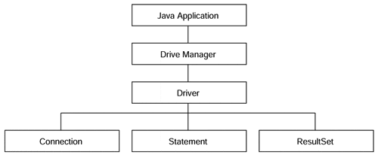
JDBC key components

Slide 30
The DriverManager Object.
Once a driver is installed, you need to load it into your Java object by using the DriverManager. It provides a common interface to a JDBC driver object without having to delve into the internals of the database itself
The driver is responsible for creating and implementing the Connection, Statement, and ResultSet objects for the specific database.
DriverManager then is able to acquire those object implementations for itself. In so doing, applications that are written using the DriverManager are isolated from the implementation details of databases.

Slide 31
Database Connection Interface.
The Connection object is responsible for establishing the link between the Database Management System and the Java application.
The Connection.getConnection method accepts a URL and enables the JDBC object to use different drivers depending on the situation, isolates applets from connection-related information, and gives the application a means by which to specify the specific database to which it should connect. The URL takes the form of
jdbc:<subprotocol>:<subname>. The subprotocol is a kind of connectivity to the database

Slide 32
Database Statement Object.
A Statement encapsulates a query written in Structured Query Language and enables the JDBC object to compose a series of steps to look up information in a database.
Using a Connection, the Statement can be forwarded to the database and obtain a ResultSet

Slide 33
ResultSet Access Control.
A ResultSet is a container for a series of rows and columns acquired from a Statement call. Using the ResultSet's iterator routines, the JDBC object can step through each row in the result set. Individual column fields can be retrieved using the get methods within the ResultSet. Columns may be specified by their field name or by their index.

Slide 34
Basic Database operations
public static void main(String[] args) {
String url = "jdbc:odbc:sach";
String userName = "ltmang";
String password = "ltmang";
try {
Class.forName("sun.jdbc.odbc.JdbcOdbcDriver");
Connection connection =
DriverManager.getConnection(url,userName,password);
Statement statement = connection.createStatement();
String sql = "select * from sach";
ResultSet rs = statement.executeQuery(sql);
while (rs.next()) {
System.out.println(rs.getString( "tens" ));
}

Slide 35
Basic Database operations
sql = "insert into sach values('P6','Tu hoc Internet'," +
"'Nha xuat ban lao đong')";
statement.executeUpdate(sql);
sql = "select * from sach";
rs = statement.executeQuery(sql);
while (rs.next()) {
System.out.println(rs.getString( "tens" ));
}
rs.close();
statement.close();
connection.close();
}
catch (Exception e) {
System.out.println( e.getMessage());
}
}

Slide 36
Basic JDBC Programming Concepts

Slide 37

Database URLs
For databases on the Internet/intranet, the subname can contain the Net URL //hostname:port/… The <subprotocol> can be any name that a database understands. The odbc subprotocol name is reserved for ODBC-style data sources. A normal ODBC database JDBC URL looks like: jdbc:odbc:<>;User=<>;PW=<>
jdbc:postgresql://www.hcmuaf.edu.vn/ts

Slide 38
Making the Connection
Loading a driver:
Class.forName(className) Class.forName("sun.jdbc.odbc.JdbcOdbcDriver");
System.setProperty(“jdbc.drivers”, “className”); System.setProperty(“jdbc.drivers”, “sun.jdbc.odbc.JdbcOdbcDriver”);
Making a connection
Connection conn = DriverManager.getConnection(…);
static Connection getConnection(String url);
static Connection getConnection(String url, String user,String password);
static int getLoginTimeout(); // seconds
static void setLoginTimeout(int seconds);
static void println(String message);// in ra logfile
static void registerDriver(Driver d);
static void deregisterDriver(Driver d);

Slide 39
Executing SQL Commands
The Statement object does all of the work to interact with the Database Management System in terms of SQL statements. You can create many Statement objects from one Connection object.
JDBC supports three types of statements:
Statement : the SQL is prepared and executed in one step (from the application program point of view)
PreparedStatement: the driver stores the execution plan handle for later use (SQL command with a parameters).
CallableStatement: the SQL statement is actually making a call to a stored procedure
The Connection object has the createStatement(), prepareStatement(), and prepareCall() methods to create these Statement objects.

Slide 40
Creating and Using Direct SQL Statements
A Statement object is created using the createStatement() method in the Connection object obtained from the call to DriverManager.getConnection
resultSet executeQuery (String sql)
int executeUpdate (String sql)
boolean execute(String sql)
The executeUpdate method can execute actions such as INSERT, UPDATE, and DELETE as well as data definition commands such as CREATE TABLE, and DROPTABLE. The executeUpdate method returns a count of the rows that were affected by the SQL command.
The executeQuery method is used to execute SELECT queries. The executeQuery object returns an object of type ResultSet that you use to walk through the result a row at a time.
ResultSet rs = stat.executeQuery("SELECT * FROM Books")

Slide 41
Using executeUpdate method
try {
Class.forName("sun.jdbc.odbc.JdbcOdbcDriver");
Connection connection =
DriverManager.getConnection(url,userName,password);
Statement statement = connection.createStatement();
String sqlCommand ="CREATE TABLE Books(Title CHAR(60),"+ "ISBN CHAR(13),Price CURRENCY)";
statement.executeUpdate(sqlCommand);
sqlCommand =" INSERT INTO Books VALUES(" +
"'Beyond HTML', '0-07-882198-3', 27.95)";
statement.executeUpdate(sqlCommand); statement.close();
connection.close();
} catch (Exception e) {
System.out.println( e.getMessage() );
}

Slide 42
Using executeQuery method
try {
Class.forName("sun.jdbc.odbc.JdbcOdbcDriver");
Connection connection = DriverManager.getConnection(url, userName,password);
Statement statement = connection.createStatement();
String sqlCommand = "SELECT * FROM BOOKS";
ResultSet rs = statement.executeQuery(sqlCommand);
while (rs.next()) {
String title = rs.getString(1);
String isbn = rs.getString(2);
float price = rs.getFloat("Price");
System.out.println(title + ", " + isbn + " , " + price);
}
rs.close();
} catch (Exception e){};

Slide 43
SQL data types and corresponding Java types
SQL data type | Java data type
INTEGER, INT, SMALLINT | int
DOUBLE PRECISION, FLOAT | double
CHARACTER(n) or CHAR(n) | String
VARCHAR(n) | String
DATE. TIMESTAMP | java.sql.Timestamp
BOOLEAN | Boolean
DEC, DECIMAL, NUMBER, NUMERIC | java.math.BigDecimal
NCHAR, NVARCHAR2 | oracle.sql.NString
BOOLEAN | Boolean

Slide 44
PreparedStatement
A PreparedStatement is a special kind of Statement object with some useful features. You can use a PreparedStatement instead of a Statement and benefit from the features of the PreparedStatement.
Easy to insert parameters into the SQL statement.
Easy to reuse the PreparedStatement with new parameters.
May increase performance of executed statements.
Enables easier batch updates.

Slide 45
Creating and Using PreparedStatement
The PreparedStatement, the driver actually sends only the execution plan ID and the parameters to the DBMS. The PreparedStatement should be used when you need to execute the SQL statement many times in a Java application. The DBMS discards the execution plan at the end of the program. The PreparedStatement object achieves faster SQL execution performance than the simple Statement object, as the DBMS does not have to run through the steps of creating the execution plan.

Slide 46
Creating and Using PreparedStatement
Notice that the executeQuery(), executeUpdate(), and execute() methods do not take any parameters.
Return Type Method Name Parameter ResultSet executeQuery ( ) int executeUpdate ( ) boolean execute ( )
One of the major features of a PreparedStatement is that it can handle IN types of parameters. The parameters are indicated in a SQL statement by placing the ? as the parameter marker instead of the actual values.

Slide 47
Creating and Using PreparedStatement
In the Java program, the association is made to the parameters with the setXXXX() methods. All of the setXXXX() methods take the parameter index, which is 1 for the first "?," 2 for the second "?,"and so on.
void setBoolean (int parameterIndex, boolean x)
void setByte (int parameterIndex, byte x)
void setDouble (int parameterIndex, double x)
void setFloat (int parameterIndex, float x)
void setInt (int parameterIndex, int x)
void setLong (int parameterIndex, long x)
void setNumeric (int parameterIndex, Numeric x)
void setShort (int parameterIndex, short x)
void setString (int parameterIndex, String x)

Slide 48
Creating and Using PreparedStatement
try {
Class.forName("sun.jdbc.odbc.JdbcOdbcDriver");
Connection connection = DriverManager.getConnection(url,userName,password);
PrepStmt = connection.prepareStatement("SELECT * FROM BOOKS WHERE ISBN = ?");
PrepStmt.setString(1,"0-07-882198-3");
ResultSet rs = PrepStmt.executeQuery();
while (rs.next()) {
title = rs.getString(1);
isbn = rs.getString(2);
price = rs.getFloat("Price");
System.out.println(title + ", " + isbn + " , " + price );
}
rs.close();
PrepStmt.close();
connection.close();
}

Slide 49
java.sql.DriverManager
static Connection getConnection(String url, String user,String password) establishes a connection to the given database and returns a Connection object.

Slide 50
java.sql.Connection
Statement createStatement() creates a statement object that can be used to execute SQL queries and updates without parameters.
PreparedStatement prepareStatement(String sql) returns a PreparedStatement object containing the precompiled statement. The string sql contains a SQL statement that can contain one or more parameter placeholders denoted by ? characters.
void close() immediately closes the current connection.

Slide 51
java.sql.Statement
close() immediately closes the current result set.
ResultSet executeQuery(String sql) executes the SQL statement given in the string and returns a ResultSet to view the query result.
int executeUpdate(String sql) executes the SQL INSERT, UPDATE, or DELETE statement specified by the string. Also used to execute Data Definition Language (DDL) statements such as CREATE TABLE. Returns the number of records affected, or -1 for a statement without an update count.

Slide 52
java.sql.Statement
boolean execute(String sql) executes the SQL statement specified by the string. Returns true if the statement returns a result set, false otherwise. Use the getResultSet or getUpdateCount method to obtain the statement outcome.
int getUpdateCount() Returns the number of records affected by the preceding update statement, or -1 if the preceding statement was a statement without an update count. Call this method only once per executed statement.
ResultSet getResultSet() Returns the result set of the preceding query statement, or null if the preceding statement did not have a result set. Call this method only once per executed statement.

Slide 53
java.sql.ResultSet
boolean next() makes the current row in the result set move forward by one. Returns false after the last row. Note that you must call this method to advance to the first row.
xxx getXxx(int columnNumber)
xxx getXxx(String columnName)
(xxx is a type such as int, double, String, Date, etc.) return the value of the column with column index columnNumber or with column names, converted to the specified type. Not all type conversions are legal. See documentation for details.
int findColumn(String columnName) gives the column index associated with a column name.

Slide 54
java.sql.PreparedStatement
void setXxx(int n, Xxx x) (Xxx is a type such as int, double, String, Date, etc.) sets the value of the n-th parameter to x.
void clearParameters() clears all current parameters in the prepared statement.
ResultSet executeQuery() executes a prepared SQL query and returns a ResultSet object.
int executeUpdate() executes the prepared SQL INSERT, UPDATE, or DELETE statement represented by the PreparedStatement object. Returns the number of rows affected, or 0 for DDL statements.

Slide 55
Scrollable and Updatable Result Sets

Slide 56
JDBC versions
Version 1.0 (1997): Include how to create a driver instance, create a database connection (via Connection object) execute SQL statements (via Statement object), return the results (through a ResultSet object), and metadata of the database and the ResultSet.
Version 2.0/2.1 (integrated into JDK 1.2): JDBC 2.0 introduces many new features to improve the performance and functionality. For example, it introduces scrollable and updatable ResultSet, batching processing.

Slide 57
JDBC versions
Version 3.0 (integrated into JDK 1.4): Transaction Savepoints
Version 4.0 (integrated into JDK 6): Autoloading of JDBC drivers. In earlier versions of JDBC, applications had to manually register drivers before requesting Connections. With JDBC 4.0 and above, applications no longer need to issue a Class.forName() on the driver name; instead, the DriverManager will find an appropriate JDBC driver when the application requests a Connection.

Slide 58
Scrollable and Updatable Result Sets
The most useful improvements in JDBC 2.0 are in the ResultSet class. As you have seen, the next method of the ResultSet class iterates over the rows in a result set.
You usually want the user to be able to move both forward and backward in the result set. But in JDBC 1, there was no previous method.The scrolling result set in JDBC 2 lets you move forward and backward through a result set and jump to any position in the result set.
Furthermore, once you display the contents of a result set to users, they may be tempted to edit it. If you supply an editable view to your users, you have to make sure that the user edits are posted back to the database. In JDBC 1, you had to program UPDATE statements. In JDBC 2, you can simply update the result set entries, and the database is automatically updated.

Slide 59
Scrollable Result Sets (JDBC 2.0)
To obtain scrolling result sets from your queries, you must obtain a different Statement object with the method
Statement stat = conn.createStatement(type, concurrency);
PreparedStatement stat = conn.prepareStatement(command, type, concurrency);
ResultSet type values:
TYPE_FORWARD_ONLY : The result set is not scrollable.
TYPE_SCROLL_INSENSITIVE: The result set is scrollable but not sensitive to database changes.
TYPE_SCROLL_SENSITIVE : The result set is scrollable and sensitive to database changes.
ResultSet concurrency values:
CONCUR_READ_ONLY :The result set cannot be used to update the database.
CONCUR_UPDATABLE :The result set can be used to update the database.

Slide 60
Scrollable Result Sets (JDBC 2.0)
For example, if you simply want to be able to scroll through a result set but you don't want to edit its data, you use:
Statement stat = conn.createStatement(ResultSet.TYPE_SCROLL_INSENSITIVE, ResultSet.CONCUR_READ_ONLY);
All result sets that are returned by method calls ResultSet rs = stat.executeQuery(query) are now scrollable. A scrolling result set has a cursor that indicates the current position.
Scrolling is very simple. You use
if (rs.previous()) . . .
to scroll backward. The method returns true if the cursor is positioned on an actual row; false if it now is positioned before the first row.

Slide 61
Scrollable Result Sets (JDBC 2)
Move the cursor backward or forward by a number of rows with the command
rs.relative(n);
If n is positive, the cursor moves forward
If n is negative, it moves backwards.
If n is zero, the call has no effect.
If you attempt to move the cursor outside the current set of rows, then, the method returns false and the cursor does not move. The method returns true if the cursor landed on an actual row.
Set the cursor to a particular row number:
rs.absolute(n);
The first row in the result set has number 1. If the return value is 0, the cursor is not currently on a row—it is either before the first or after the last row.

Slide 62
Updatable Result Sets (JDBC 2)
If you want to be able to edit result set data and have the changes automatically reflected in the database, you need to create an updatable result set.
Statement stat = conn.createStatement(ResultSet.TYPE_SCROLL_INSENSITIVE, ResultSet.CONCUR_UPDATABLE);
Then, the result sets returned by a call to executeQuery are updatable.
NOTE: Not all queries return updatable result sets. If your query is a join that involves multiple tables, the result may not be updatable.
For example, suppose you want to raise the prices of some books, but you don't have a simple criterion for issuing an UPDATE command. Then, you can iterate through all books and update prices, based on arbitrary conditions.

Slide 63
Updatable Result Sets (JDBC 2)
String query = "SELECT * FROM Books";
ResultSet rs = stat.executeQuery(query);
while (rs.next()) {
if (. . .){
double increase = . . .
double price = rs.getDouble("Price");
rs.updateDouble("Price", price + increase);
rs.updateRow();
}
}
There are updateXxx methods for all data types that correspond to SQL types, such as updateDouble, updateString, and so on. As with the getXxx methods, you specify the name or the number of the column. Then, you specify the new value for the field.

Slide 64
Updatable Result Sets (JDBC 2)
The updateXxx method only changes the row values, not the database. When you are done with the field updates in a row, you must call the updateRow method. That method sends all updates in the current row to the database.
If you move the cursor to another row without calling updateRow, all updates are discarded from the row set and they are never communicated to the database. You can also call the cancelRowUpdates method to cancel the updates to the current row.
If you want to add a new row to the database, you first use the moveToInsertRow method to move the cursor to a special position, called the insertRow. You build up a new row in the insert row position by issuing updateXxx instructions. Finally, when you are done, call the insertRow method to deliver the new row to the database. When you are done inserting, call moveToCurrentRow to move the cursor back to the position before the call to moveToInsertRow.

Slide 65
Updatable Result Sets (JDBC 2)
rs.moveToInsertRow();
rs.updateString("Title", title);
rs.updateString("ISBN", isbn);
rs.updateDouble("Price", price);
rs.insertRow();
rs.moveToCurrentRow();
Finally, you can delete the row under the cursor.
rs.deleteRow();
The deleteRow method immediately removes the row from both the result set and the database.
The updateRow, insertRow, and deleteRow methods of the ResultSet class give you the same power as executing UPDATE, INSERT, and DELETE SQL commands.

Slide 66
javax.sql.Connection
Statement createStatement(int type, int concurrency)
PreparedStatement prepareStatement(String command, int type, int concurrency)
(JDBC 2) create a statement or prepared statement that yields result sets with the given type and concurrency.
Parameters: command : the command to prepare type : one of the constants TYPE_FORWARD_ONLY, TYPE_SCROLL_INSENSITIVE, or TYPE_SCROLL_SENSITIVE concurrency: one of the constants CONCUR_READ_ONLY or CONCUR_UPDATABLE

Slide 67
java.sql.ResultSet
int getType() Returns the type of this result set, one of TYPE_FORWARD_ONLY, TYPE_SCROLL_INSENSITIVE, or TYPE_SCROLL_SENSITIVE.
int getConcurrency() Returns the concurrency setting of this result set, one of CONCUR_READ_ONLY or CONCUR_UPDATABLE.
boolean previous() Moves the cursor to the preceding row. Returns true if the cursor is positioned on a row.
int getRow() Gets the number of the current row. Rows are numbered starting with 1.
boolean absolute(int row) Moves the cursor to row row. Returns true if the cursor is positioned on a row.

Slide 68
java.sql.ResultSet
boolean relative(int d) Move the cursor by d rows. If d is negative, the cursor is moved backward. Returns true if the cursor is positioned on a row.
boolean first()
boolean last() Move the cursor to the first or last row. Return true if the cursor is positioned on a row.
void beforeFirst()
void afterLast() Move the cursor before the first or after the last row.
boolean isFirst()
boolean isLast() Test if the cursor is at the first or last row.

Slide 69
java.sql.ResultSet
boolean isBeforeFirst()
boolean isAfterLast() Test if the cursor is before the first or after the last row.
void moveToInsertRow() Moves the cursor to the insert row. The insert row is a special row that is used for inserting new data with the updateXxx and insertRow methods.
void moveToCurrentRow() Moves the cursor back from the insert row to the row that it occupied when the moveToInsertRow method was called.
insertRow() Inserts the contents of the insert row into the database and the result set.

Slide 70
java.sql.ResultSet
void deleteRow() Deletes the current row from the database and the result set.
void updateXxx(int column, Xxx data)
void updateXxx(String columnName, Xxx data) (Xxx is a type such as int, double, String, Date, etc.) Update a field in the current row of the result set.
void updateRow() Sends the current row updates to the database.
void cancelRowUpdates() Cancels the current row updates.

Slide 71
Metadata
JDBC can give you additional information about the structure of a database and its tables. For example, you can get a list of the tables in a particular database or the column names and types of a table.
To find out more about the database, you need to request an object of type DatabaseMetaData from the database connection.
DatabaseMetaData meta = conn.getMetaData();
Now you are ready to get some metadata. For example, the call
ResultSet rs = meta.getTables(null, null, null, new String[] { "TABLE" });
returns a result set that contains information about all tables in the database.

Slide 72
Extract Table Info - Table
databaseMetaData = connection.getMetaData();
//Print TABLE_TYPE "TABLE"
ResultSet resultSet = databaseMetaData.getTables(null, null, null, new String[]{"TABLE"});
System.out.println("Printing TABLE");
while(resultSet.next()){
//Print System.out.println( resultSet.getString("TABLE_NAME"));
}

Slide 73
Extract Table Info - System Table
databaseMetaData = connection.getMetaData();
//Print TABLE_TYPE "TABLE"
ResultSet resultSet = databaseMetaData.getTables(null, null, null, new String[]{"SYSTEM TABLE"});
System.out.println("Printing SYSTEM TABLE");
while(resultSet.next()){
//Print System.out.println( resultSet.getString("TABLE_NAME"));
}

Slide 74
ResultSetMetaData
ResultSetMetaData reports information about a result set. Whenever you have a result set from a query, you can inquire about the number of columns and each column's name, type, and field width. We will make use of this information to make a label for each name and a text field of sufficient size for each value.
ResultSet rs = stat.executeQuery("SELECT * FROM " + tableName);
ResultSetMetaData meta = rs.getMetaData();
for (int i = 1; i <= meta.getColumnCount(); i++) {
String columnName = meta.getColumnLabel(i);
int columnWidth = meta.getColumnDisplaySize(i);
. . .
}

Slide 75
Extract Column Info
ResultSet columns = databaseMetaData.getColumns(null, null, tableName, null);
while(columns.next()){
String columnName = columns.getString("COLUMN_NAME");
String datatype = columns.getString("DATA_TYPE");
String columnsize = columns.getString("COLUMN_SIZE");
String decimaldigits = columns.getString("DECIMAL_DIGITS");
String isNullable = columns.getString("IS_NULLABLE");
String is_autoIncrment = columns.getString("IS_AUTOINCREMENT");
//Printing results
System.out.println();
}

Slide 76
java.sql.Connection
DatabaseMetaData getMetaData() returns the metadata for the connection as a DataBaseMetaData object.

Slide 77
java.sql.DatabaseMetaData
ResultSet getTables(String catalog, String schemaPattern, String tableNamePattern, String types[]) gets a description of all tables in a catalog that match the schema and table name patterns and the type criteria. The catalog and schema parameters can be "" to retrieve those tables without a catalog or schema, or null to return tables regardless of catalog or schema.
The types array contains the names of the table types to include. Typical types are TABLE, VIEW, SYSTEM TABLE, GLOBAL TEMPORARY, LOCAL TEMPORARY, ALIAS, and SYNONYM. If types is null, then tables of all types are returned.

Slide 78
java.sql.DatabaseMetaData
The types array contains the names of the table types to include. Typical types are TABLE, VIEW, SYSTEM TABLE, GLOBAL TEMPORARY, LOCAL TEMPORARY, ALIAS, and SYNONYM. If types is null, then tables of all types are returned.
The result set has five columns, all of which are of type String:
1 TABLE_CAT Table catalog (may be null) 2 TABLE_SCHEM Table schema (may be null) 3 TABLE_NAME Table name 4 TABLE_TYPE Table type 5 REMARKS Comment on the table

Slide 79
java.sql.DatabaseMetaData
int getJDBCMajorVersion()
int getJDBCMinorVersion()
(JDBC 3) Return the major and minor JDBC version numbers of the driver that established the database connection. For example, a JDBC 3.0 driver has major version number 3 and minor version number 0.
int getMaxStatements()
Returns the maximum number of concurrently open statements per database connection, or 0 if the number is unlimited or unknown.

Slide 80
java.sql.ResultSet
ResultSetMetaData getMetaData() gives you the metadata associated with the current ResultSet columns.

Slide 81
java.sql.ResultSetMetaData
int getColumnCount() returns the number of columns in the current ResultSet object.
int getColumnDisplaySize(int column) tells you the maximum width of the column specified by the index parameter.
String getColumnLabel(int column) gives you the suggested title for the column.
String getColumnName(int column) gives the column name associated with the column index specified.

Slide 82
Transactions
The major reason for grouping commands into transactions is database integrity.
If you group updates to a transaction, then the transaction either succeeds in its entirety and it can be committed, or it fails somewhere in the middle. In that case, you can carry out a rollback and the database automatically undoes the effect of all updates that occurred since the last committed transaction.
By default, a database connection is in autocommit mode, and each SQL command is committed to the database as soon as it is executed. Once a command is committed, you cannot roll it back.

Slide 83
Transactions
Transactions enable you to control if, and when, changes are applied to the database. It treats a single SQL statement or a group of SQL statements as one logical unit, and if any statement fails, the whole transaction fails.
To enable manual - transaction support instead of the auto-commit mode that the JDBC driver uses by default, use the Connection object's setAutoCommit() method. If you pass a boolean false to setAutoCommit( ), you turn off auto-commit. You can pass a boolean true to turn it back on again.
For example, code the following to turn off auto –commit: conn.setAutoCommit(false);

Slide 84
Transactions
Commit & Rollback
Once you are done with your changes and you want to commit the changes then call commit() method on connection object as follows:
conn.commit( );
Otherwise, to roll back updates to the database made using the Connection named conn, use the following code:
conn.rollback( );

Slide 85
Transactions
try{
//Assume a valid connection object conn
conn.setAutoCommit(false);
Statement stmt = conn.createStatement();
String SQL = "INSERT INTO Employees " +
"VALUES (106, 20, 'Rita', 'Tez')";
stmt.executeUpdate(SQL);
//Submit a malformed SQL statement that breaks
String SQL = "INSERTED IN Employees " +
"VALUES (107, 22, 'Sita', 'Singh')";
stmt.executeUpdate(SQL);
// If there is no error.
conn.commit();
}catch(SQLException se){
// If there is any error.
conn.rollback();
}

Slide 86
Using Savepoints
The new JDBC 3.0 Savepoint interface gives you the additional transactional control. Most modern DBMS, support savepoints within their environments such as Oracle's PL/SQL.
When you set a savepoint you define a logical rollback point within a transaction. If an error occurs past a savepoint, you can use the rollback method to undo either all the changes or only the changes made after the savepoint.

Slide 87
Using Savepoints
The Connection object has two new methods that help you manage savepoints:
setSavepoint(String savepointName): Defines a new savepoint. It also returns a Savepoint object.
releaseSavepoint(Savepoint savepointName): Deletes a savepoint. Notice that it requires a Savepoint object as a parameter. This object is usually a savepoint generated by the setSavepoint() method.
There is one rollback (String savepointName) method, which rolls back work to the specified savepoint.

Slide 88
Using Savepoints
try{
//Assume a valid connection object conn
conn.setAutoCommit(false);
Statement stmt = conn.createStatement();
//set a Savepoint
Savepoint savepoint1 = conn.setSavepoint("Savepoint1");
String SQL = "INSERT INTO Employees " +
"VALUES (106, 20, 'Rita', 'Tez')";
stmt.executeUpdate(SQL);
//Submit a malformed SQL statement that breaks
String SQL = "INSERTED IN Employees " +
"VALUES (107, 22, 'Sita', 'Tez')";
stmt.executeUpdate(SQL);
// If there is no error, commit the changes.
conn.commit();
}catch(SQLException se){
// If there is any error.
conn.rollback(savepoint1);
}

Slide 89
Batch Updates
Batch Processing allows you to group related SQL statements into a batch and submit them with one call to the database.
The addBatch() method of Statement, PreparedStatement, and CallableStatementis used to add individual statements to the batch. The executeBatch() is used to start the execution of all the statements grouped together.
The executeBatch() returns an array of integers, and each element of the array represents the update count for the respective update statement.
Just as you can add statements to a batch for processing, you can remove them with the clearBatch() method. This method removes all the statements you added with the addBatch() method.

Slide 90
Batching with Statement
Create a Statement object using either createStatement() methods.
Set auto-commit to false using setAutoCommit().
Add as many as SQL statements you like into batch using addBatch() method on created statement object.
Execute all the SQL statements using executeBatch() method on created statement object.
Finally, commit all the changes using commit() method.

Slide 91
Batching with Statement
// Create statement object
Statement stmt = conn.createStatement();
// Set auto-commit to false
conn.setAutoCommit(false);
// Create SQL statement
String SQL = "INSERT INTO Employees . . . ";
// Add above SQL statement in the batch.
stmt.addBatch(SQL);
// Create one more SQL statement
String SQL = "INSERT INTO Employees . . . ";
// Add above SQL statement in the batch.
stmt.addBatch(SQL);
// Create one more SQL statement
String SQL = "UPDATE Employees SET . . . " ;
// Add above SQL statement in the batch.
stmt.addBatch(SQL);
// Create an int[] to hold returned values
int[] count = stmt.executeBatch();
//Explicitly commit statements to apply changes
conn.commit();

Slide 92
Batching with PrepareStatement
Create SQL statements with placeholders.
Create PrepareStatement object using either prepareStatement() methods.
Set auto-commit to false using setAutoCommit().
Add as many as SQL statements you like into batch using addBatch() method on created statement object.
Execute all the SQL statements using executeBatch() method on created statement object.
Finally, commit all the changes using commit() method

Slide 93
Batching with PrepareStatement
// Create SQL statement
String SQL = "INSERT INTO Employees (id, first, last, age) VALUES(?, ?, ?, ?)";
// Create PrepareStatement object
PreparedStatemen pstmt = conn.prepareStatement(SQL);
//Set auto-commit to false
conn.setAutoCommit(false);
// Set the variables
pstmt.setInt( 1, 400 );
pstmt.setString( 2, "xxxxx" );
. . . . . . . . .
// Add it to the batch
pstmt.addBatch();

Slide 94
Batching with PrepareStatement
// Set the variables
pstmt.setInt( 1, 401 );
pstmt.setString( 2, "zzzzz" );
. . . . . . . . . . .
// Add it to the batch
pstmt.addBatch();
//add more batches
. . . . .
//Create an int[] to hold returned values
int[] count = stmt.executeBatch();
//Explicitly commit statements to apply changes
conn.commit();

